Slide 1
Architectural Support for Software Fault Tolerance
Final Project Presentation
Reconfigurable Computing
CPRE 583 Fall 2010
Dec 10th 2010
Parijat Shukla
Selva Kumar S
Ashish Daga

Slide 2
    Project Overview
    Software Fault Tolerance Techniques using Leon processors has a been a more viable research area.
    The Hybrid Fault-Tolerant scheme is still to be explored upon.
    In this scheme part of the software-fault tolerance techniques is basically offloaded to the hardware.
    Ensures speedup of the fault tolerance.

Slide 3
Objectives of the Project
We combine two or more existing approaches for software fault tolerance and study the tradeoffs. We focus our present work to:
Identify ways to full (or partial) combination of more than one existing approaches, in a complementary way.
Study the fault coverage
Hardware and complexity overhead
Performance overhead

Slide 4
Our Approach
Combine re-computation and check-pointing & recovery methods partially (or fully) to design a hybrid method of software fault tolerance
Modify N-version programming based software fault tolerance approach and provide architectural support for the implementation of the same

Slide 5
Taxonomy of Fault Tolerance
Most of these FT modes are currently being used at UF
NMR
Temporal and spatial
variants possible
for many techniques
FT-HLL
N-Modular
Redundancy
SIFT
Fault-Tolerant
HLL (e.g. MPI)
Software-Implemented
Fault Tolerance
CED
CR
Concurrent Error
Detection
Checkpointing
& Roll-back
Detect
Correct
or
Mask
SCP
BR
Self-Checking
Pairs
Byzantine
Resilience
ABFT
NVP
Algorithm-Based
Fault-Tolerance
ECC
N-Version
Programming
Error Correction
Codes
Source: National Center for High Performance Reconfigurable Computing(NCHRC), ECE dept, UF

Slide 6
Software Fault Tolerance
General Fault Tolerance
Fault Tolerance against
  transient errors or permanent failures
  Design faults
Time/+space redundancy
Time and/or space overhead

Slide 7
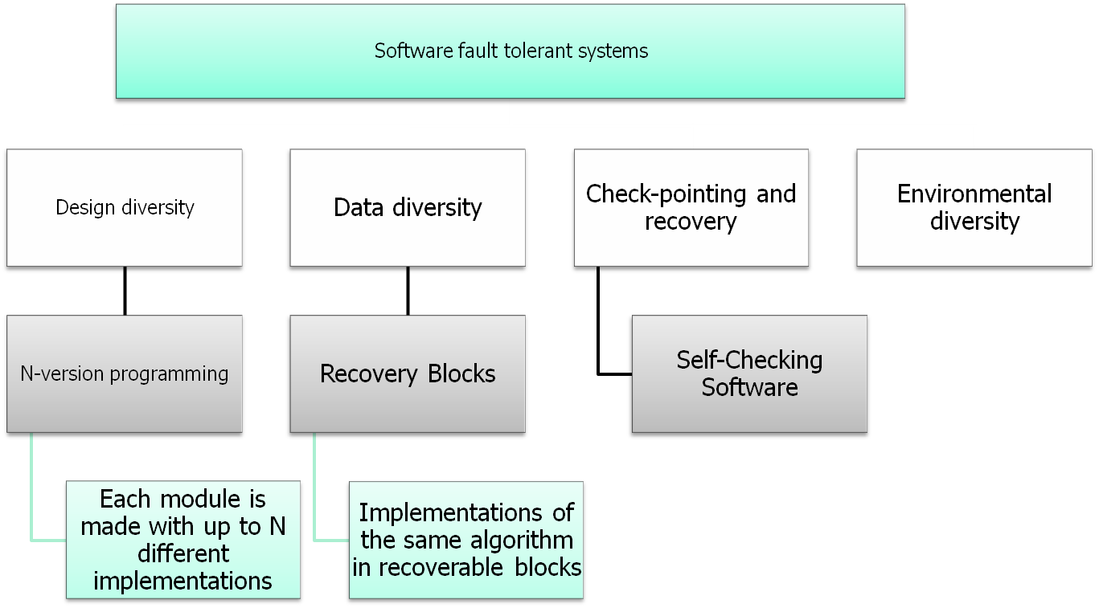
Fault tolerant systems

Slide 8
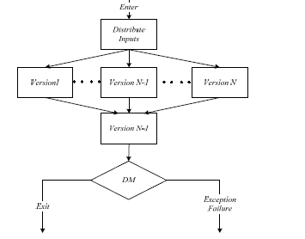

N version programming

Slide 9
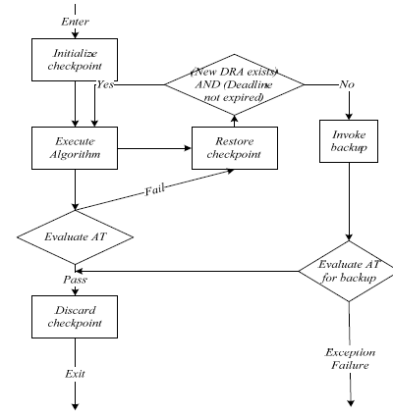
Recovery scheme

Slide 10
Why N Version
N-version programming guarantees a forward recovery in the face of faults. Today, when performance has attained greater importance than ever, forward recovery is desirable
Balance the execution overhead associated with execution of N-versions of a program with low overhead hardware based implementation. This approach shall have overhead comparable to other approaches, while guaranteeing forward recovery

Slide 11
Design
  Overhead involved in decision making scales exponentially with # of versions
  Modular Programming provides opportunity for increased Instruction Level Parallelism(ILP)
  With ever increasing computing faults, lightweight Fault Tolerant Systems are required, especially for space and mission critical applications
  Lesser hardware consumes lesser power and dissipates lesser heat

Slide 12
Design Overview
Program
Program
Ver-1
Ver-1
Ver-2
……
Ver-2
Ver-N
……
Decision Making
Ver-N
Decision Making

Slide 13
Programming Model
Supports Modular Programming
  Fault prone/Critical Components should be in a module
  Model can be generalized
declarations
Module-1
Module-2
Module-3
Module-n

Slide 14
Fault Tolerant Program Execution
Syntactical support: FT_START, FT_END marks the start, end of the fault tolerant portion
Current PC and NPC are saved
Special registers: PC_V1, PC_V2.. PC_Vn are loaded with the memory address FT versions
RES_V1, RES_V2, RES_V3 are cleared
functionally equivalent versions are executed sequentially
PC is loaded with value of PC_V1 first FT version is executed and so on..
Bit 18 of PSR is set to indicate the presence of the execution result for version 1
Results are compared to ensure fault tolerance, and bits 15-14 are set appropriately

Slide 15
Program Execution
.
.
.
.
int a
FT_START //fault tolerant block starts here
a = N_version (F_V1, F_V2, F_V3);
FT_END //fault tolerant block ends here
ADDRESS
.
.
100
.
.
200
.
.
300
.
.
INSTRUCTION
.
.
MOV PC PC_V1
.
.
MOV PC PC_V2
.
.
MOV PC PC_V3
.
.
SAVE PC, NPC
LOAD PC_V1, PC_V2, PC_V3
CLEAR RES_V1, RES_V2, RES_V3
FETCH FROM PC_V1 AND EXECUTE
LOAD RESULT INTO RES_V1
FETCH FROM PC_V2 AND EXECUTE
LOAD RESULT INTO RES_V2
FETCH FROM PC_V3 AND EXECUTE
LOAD RESULT INTO RES_V3
Fault tolerant version of a program in a high level language
Pseudo code for the fault tolerant version of program

Slide 16
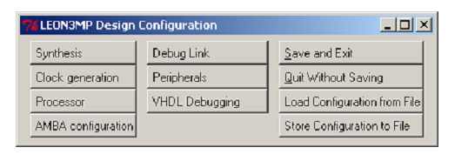
Implementation
Leon3 is an open source soft-core processor which can be configured based on the requirements
Initiate Configuration based on the GUI
Ensure one UART enabled
Customized Configuration Support
Leon 3 provides support for various platforms – Both Xilinx & Altera

Slide 17
Leon 3 Processor on ML507
Ensure the Leon 3 configuration simulates in ModelSim and hence verify Configuration correctness
Modelsim ensures verification of LEON IP cores.
Synthesis & Place and Route and with various tools supported.
Xilinx ISE Tools supported by Leon 3.
Generation of configuration bit file for the ML507.
Download the target to the FPGA.

Slide 18
BCC – Bare-C Cross Compiler
Cross-Compiler for Leon3 processor
Ensures support for high level languages C/C++
Leon 3 Boot proms generation from high level language to run on target.
Produced binaries will run on both LEON2 and LEON3 systems.
Ensure support for MUL/DIV instructions of Leon 3
Binaries run on the simulator and debugger.
MAC instructions need to be coded in assembly.

Slide 19
TSIM – Simulator for Leon 3
TSIM is a generic SPARC architecture simulator capable of emulating ERC32- and LEON-based computer
Accurate and cycle-true emulation of ERC32 and LEON2/3/4 processors
Load and Simulate Applications via command line.
Can provide disassembly code and performance statistics of loaded application

Slide 20
GRMON Debug Monitor
GRMON is a general debug monitor for the LEON processor.
Features :
  Read/write access to all system registers and memory
  Built-in disassembler and trace buffer management
  Downloading and execution of LEON applications
  Breakpoint and watchpoint management
  Support for USB(xilusb), JTAG, RS232,

Slide 21
GRMON Debug Monitor Contd…
Ensure the target FPGA is loaded with the leon3 bit file.
Launch GRMON and ensure correctness to the Leon design.
Automatic Detection of IP Cores ensures detection of of Leon processor on FPGA.
Load Hello World Program to ensure the processor executes the same.
Benchmark Program ensures correctness of the Leon IP Cores.

Slide 22
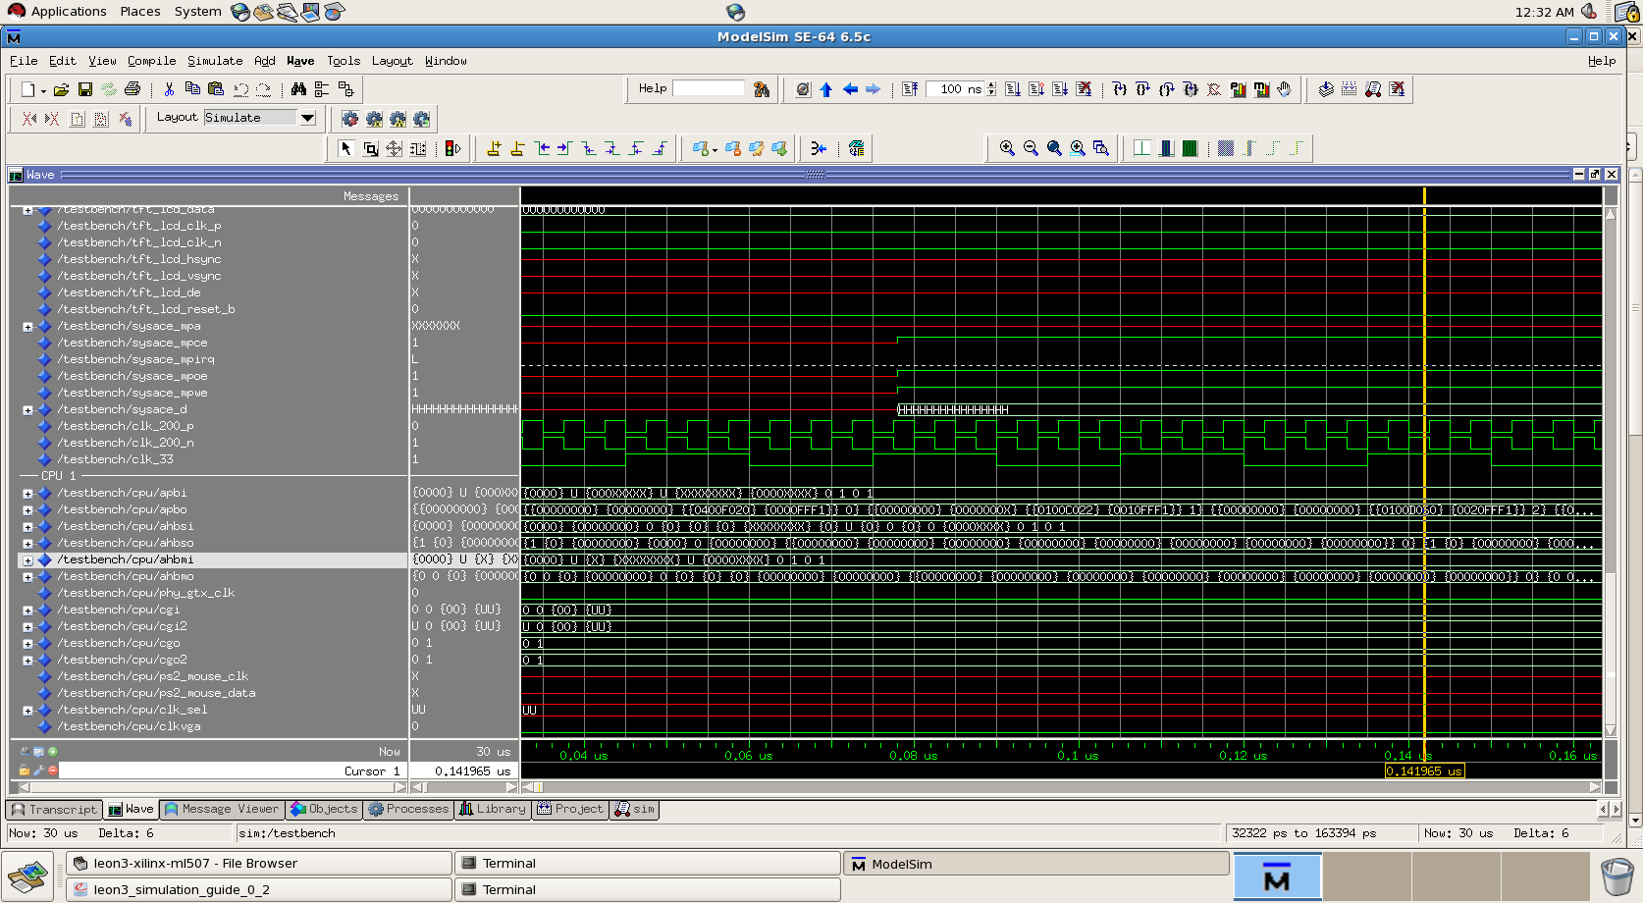
LEON 3 Processor Design Simulation

Slide 23
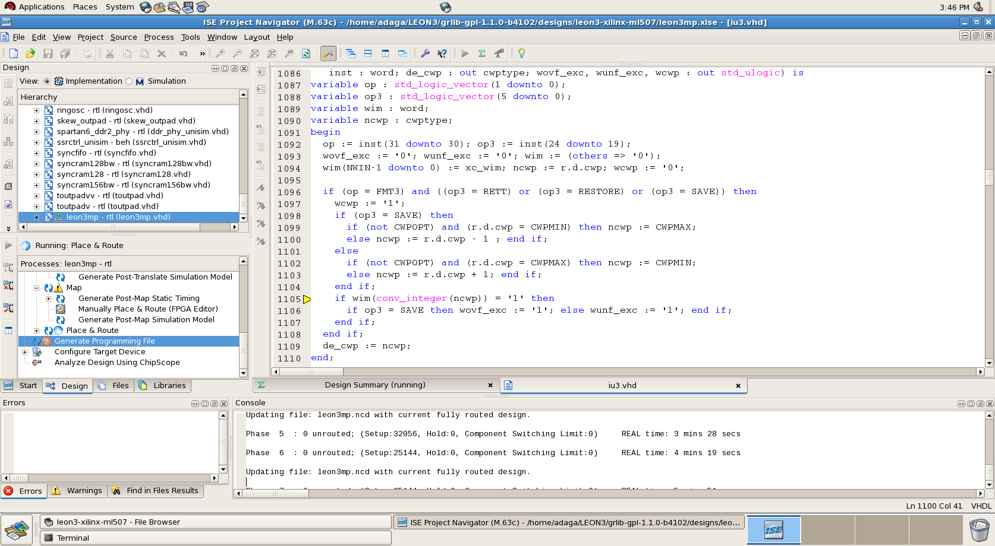
Synthesis and BIT File Generation

Slide 24
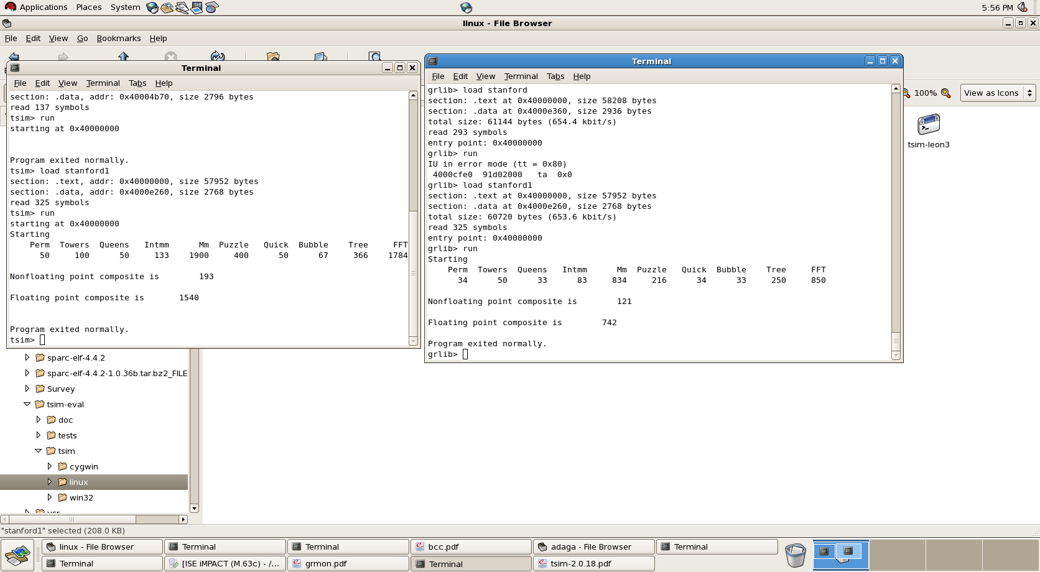
Benchmark Program TSIM Versus Hardware

Slide 25
Implementation Procedure
LEON 3 Configuration - XCONFIG
Compilation - BCC SPARC for LEON 3
Programming File Generation–
Xilinx ISE Tools
Application Verification on
Console(Ensure UART enabled)
Simulation - TSIM Leon 3 Simulator
Verification of
LEON Design and Download
to FPGA -
MODELSIM & IMPACT
Debugging - GRMON DEBUG MONITOR

Slide 26
Expected Results
The below table shows the result comparison of the N-Version Software program versus the Hardware supported Fault Tolerant Version
Program | Cycles | Instructions | CPI | Bytes
Power_FT | 7877 | 4258 | 1.85 | Text :25408 Data:2628
Power_ASM | 7931 | 4255 | 1.86 | Text:25376 Data:2628

Slide 27
Challenges Faced
LEON 3 Processor Configuration Issues (Eg:UART Enabling for Console Echo)
Configuration environments for the various tools used during the development phase – BCC,TSIM & GRMON.
The Prom file targeted towards the hardware required administrator rights on the machine.
Introduction of SPARC v8 Instructions in the C program and compilation of the same.

Slide 28
References
Fault-tolerant computing - DAVID A.RENNELS, Encyclopedia of Computer Science,1999.
Architecting Dependable Systems – Vol II and III, Lecture Notes in Computer Science , Springer
http://ieeexplore.ieee.org
Osamah A. Rawashdeh and James E. Lumpp, Jr ―Run time behavior of Adrea: A dynamically reconfigurable Distributed Embedded control architecture‖ IEEEAC paper#1516, December 2005
John M. Emmert, Charles E. Stroud, , and Miron Abramovici, ―Online Fault Tolerance for FPGA Logic Blocks‖ IEEE TRANSACTIONS ON VERY LARGE SCALE INTEGRATION (VLSI) SYSTEMS, VOL. 15, NO. 2, FEBRUARY 2007
Greenwood, ―On The Practicality Of Using Intrinsic Reconfiguration For Fault Recovery‖ IEEE Transactions On Evolutionary Computation, Vol. 9, No. 4, August 2005
A survey of software fault tolerance techniques, et. al Aaipeng Xie, Hongyu Sun, Kewal Saluja
N-version Programming: A Fault Tolerance Approach to Reliability of Software Operations, Liming Chan and Algirdas Avizienis, in Proceedings of FTCS-25, Volume 3, 1996.
Data Diversity: An approach to software fault tolerance, Paul E. Ammann and John C. Knight, IEEE transactions on Computers, Vol. 37, no. 4, April 1998.
Impact of Faults in Different Software Systems: A Suevry, Neeraj Mohan , Parvinder S. Sandhu and Hardeep Singh, World Academy of Science, Engineering and Technology 2009.

Slide 29


